Slide 1
Kivy Showcase
A short exploration of how Kivy is
changing the world
www.kivy.org

Slide 2
What is Kivy?
Platfrom agnostic (Android, iOS, Win, Mac, Linux)
Full stack Python/Cython framework
Supports RAD (Full GUI toolkit, KV language)
Multi-touch
Hardware accelerated (OpenGL ES 2)
Self-contained
Open Source, MIT licensed

Slide 3
Why Kivy?
Modern and well designed
Follows best practises
Leverages well-known design patterns
Fast
Produces novel, engaging interfaces
Well designed and maintained
TLDR: It's Awesome!

Slide 4
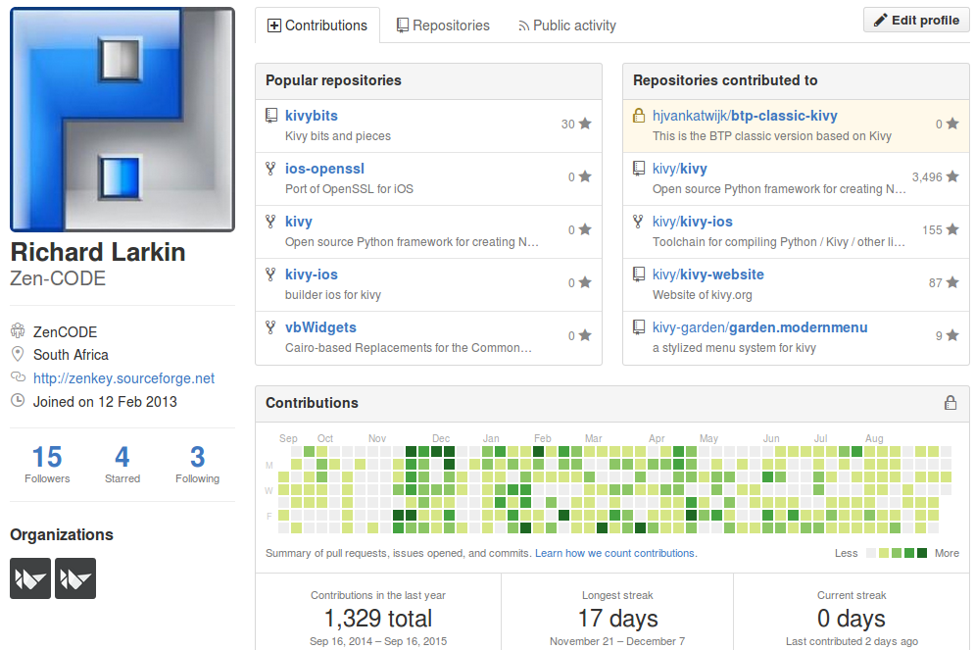
Why me?
Living proof that Kivy makes dunces productive
Notes:
Educational software developer
Kivy contributor
Moonlighting on Kivy project port helping the aged and mentally ill

Slide 5
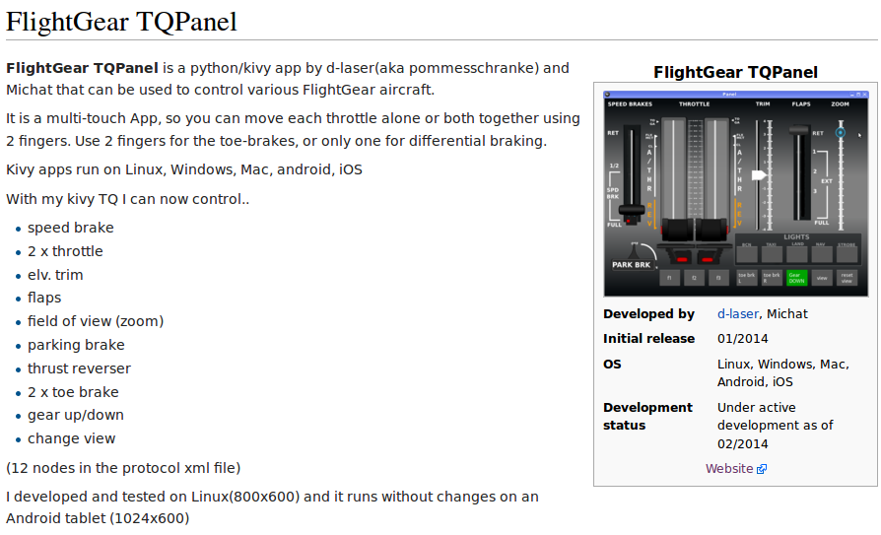
Gaming

